Slide 1

Topic: Zombie and Execl Process
Lecture: Dr. Zhao Jie
Date: 01/28/2026

Slide 2
Zombie Process
Zombie process
Zombie process is the process that is terminated, but its entry is still in the process table. For example, the child process created by the parent process finishes before the parent process does.
The system call for creating the orphan process
Sleep()

Slide 3
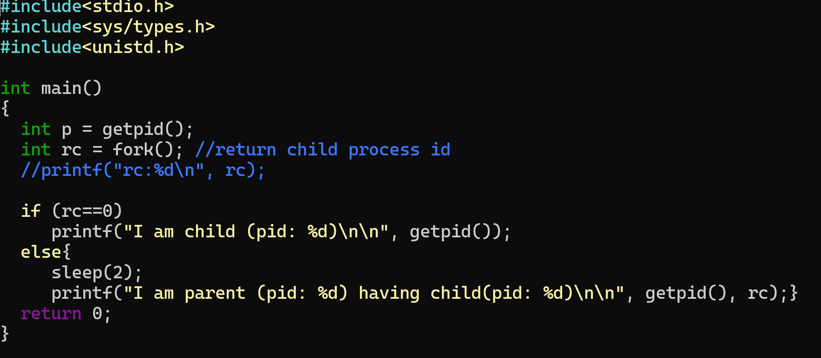
Zombie Process

Slide 4
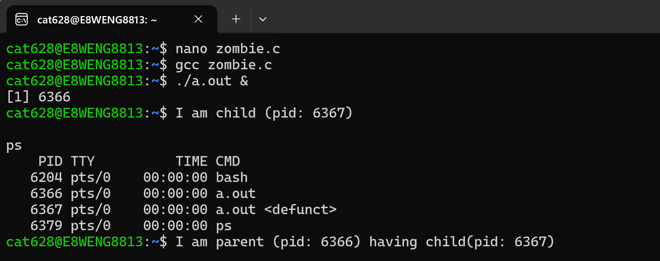
Zombie Process Output

Slide 5
Orphan Process
Orphan process
An orphan process is a process whose parent has finished.
The system call for creating the orphan process
Sleep()

Slide 6
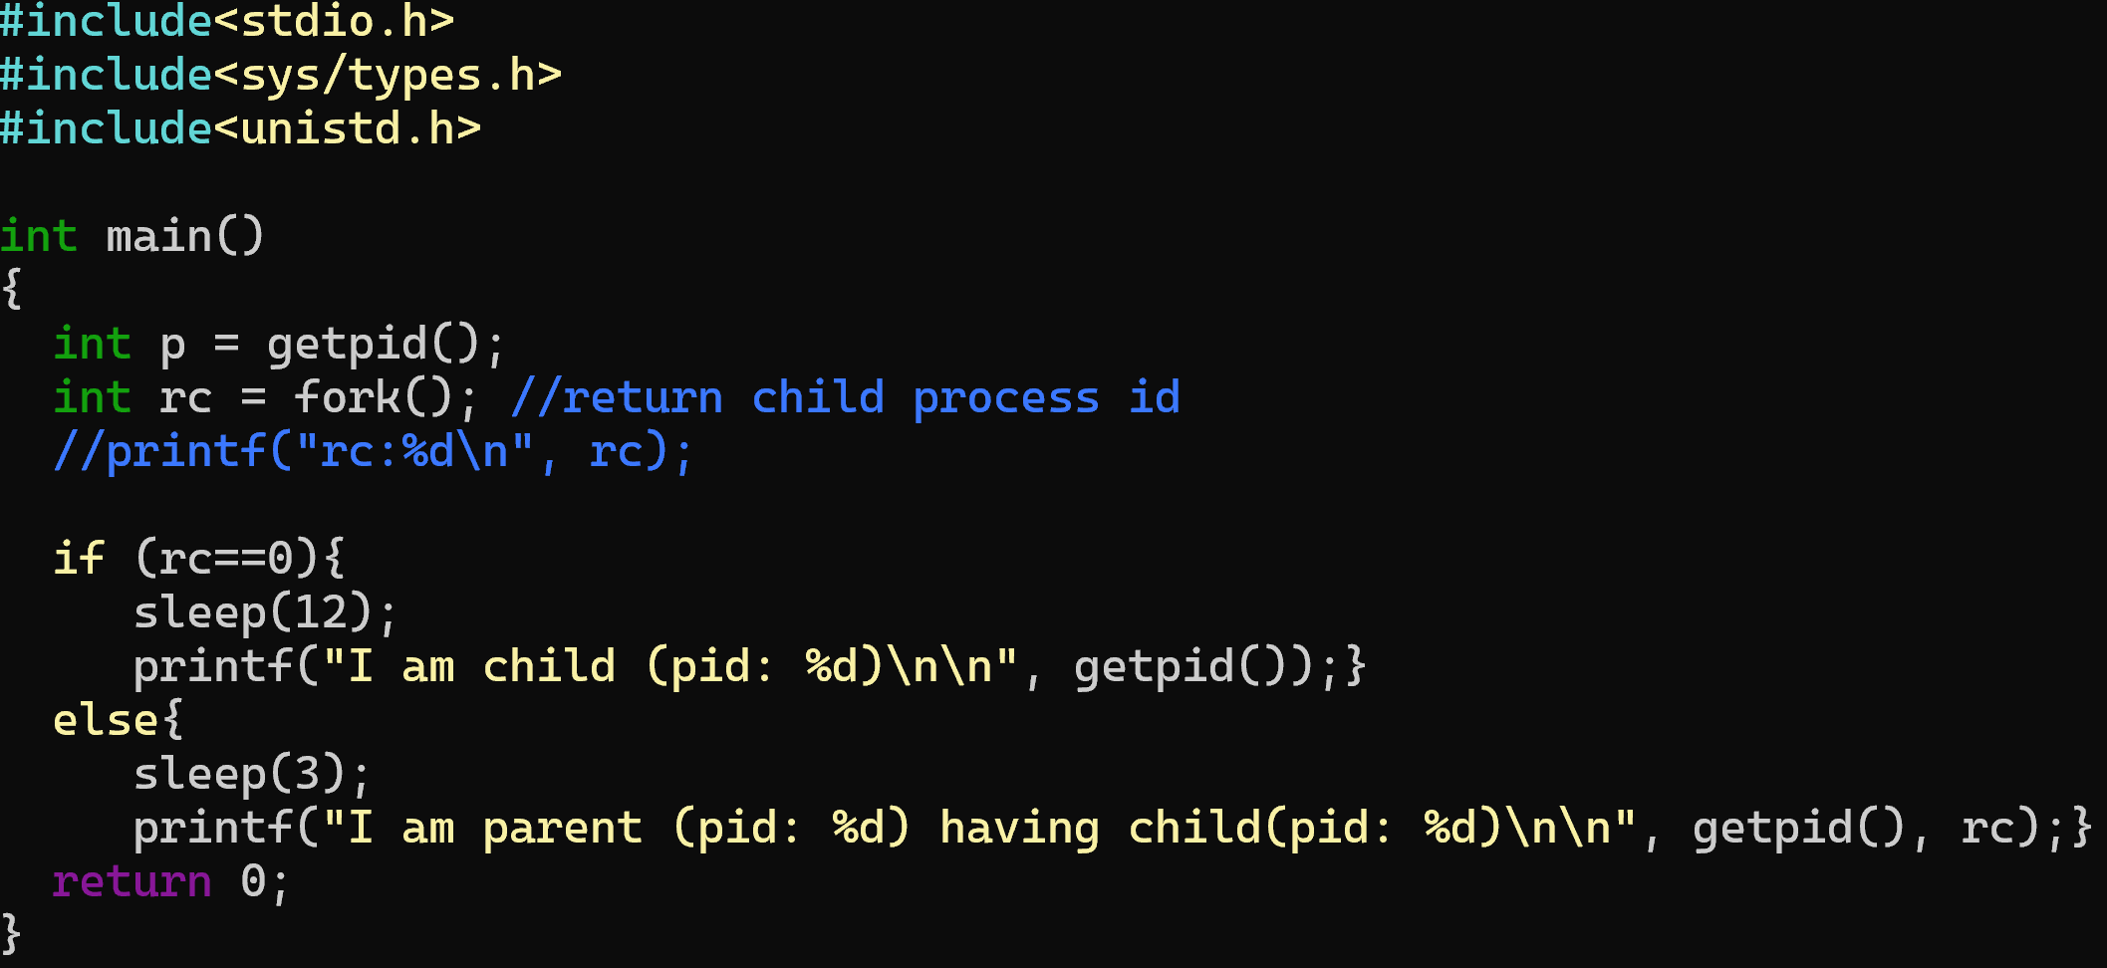
Orphan Process

Slide 7
The role of execl()
After running fork()
After running fork(), both parent and child processes have the same code. However, unlike human being, the original purpose of such a reproduction is not for genetic inheritance, but for the code diversity.
Using execl()
To support the code diversity, execl() is explored. The synopsis is show
Func: Replaces the current process image with a new one, specified by a path.
*Arg1: The path to the new process image file
Arg2: a list of pointers to null-terminated strings that represent the argument list for the new process
Arg3: By default, set it NULL
Return: Return -1 if on failure.

Slide 8
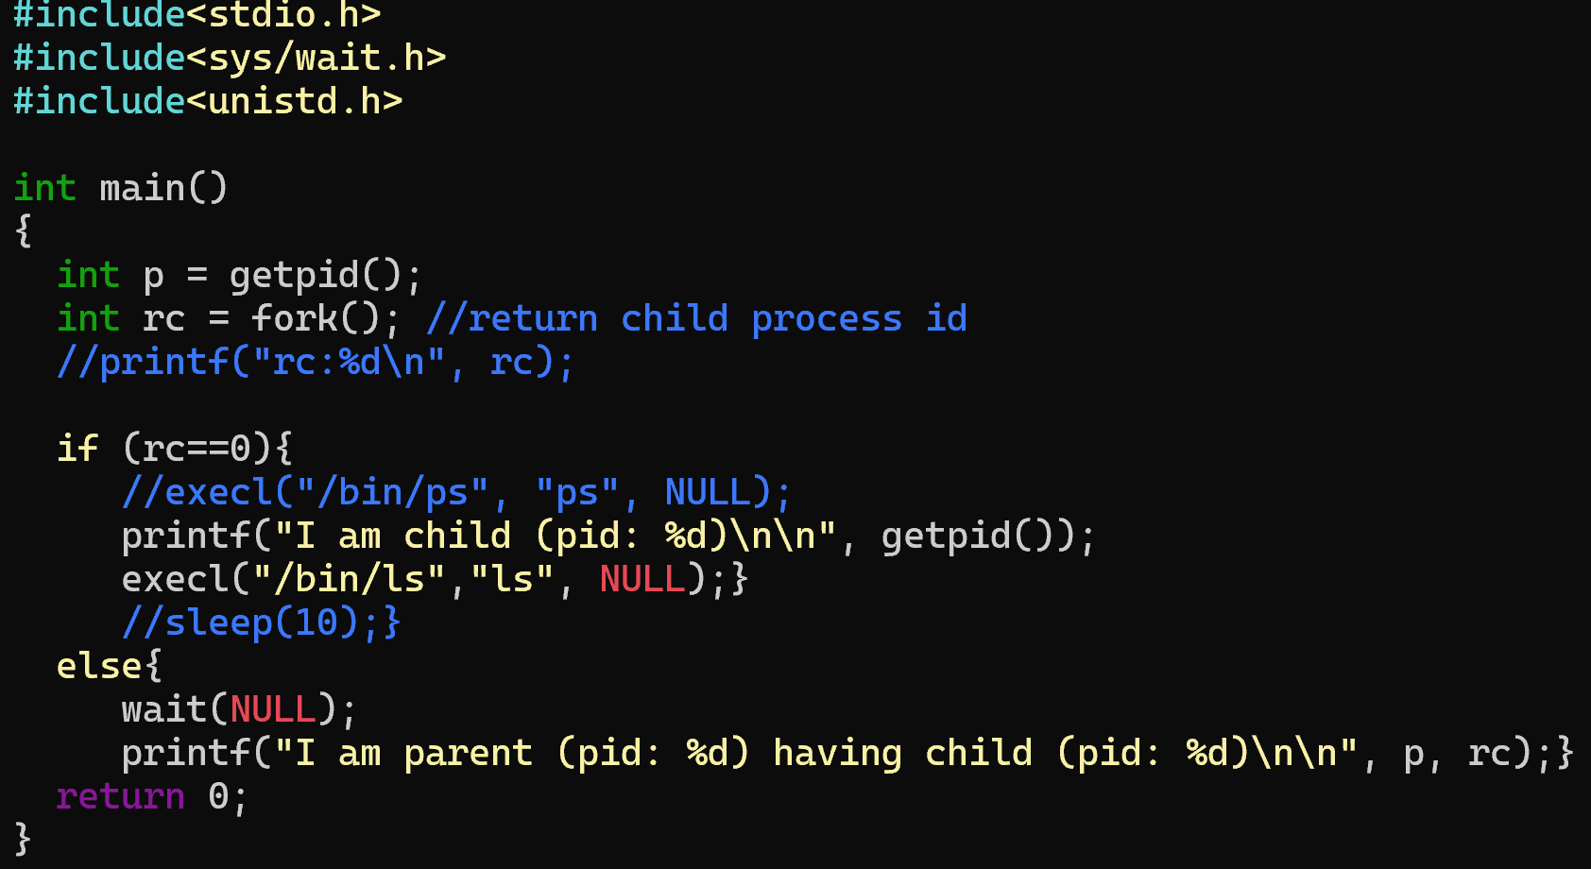
Execl Process

Slide 9
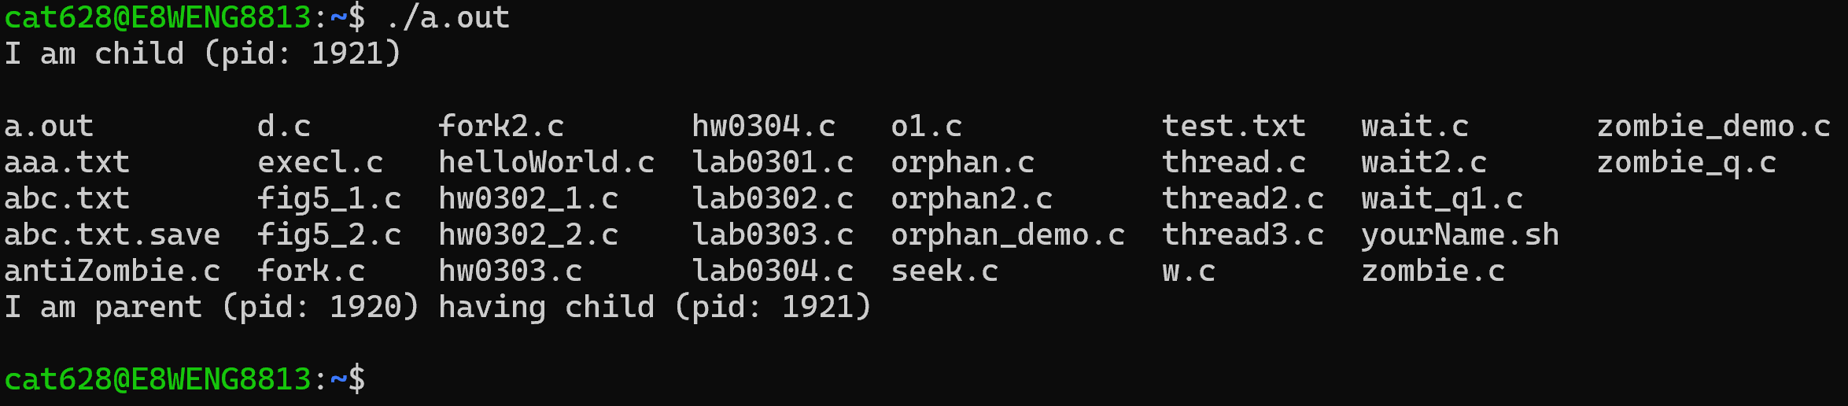
Execl Process Output

